Slide 1


Mobile Learning Application Development
Presented By:
Rakib Hossen
Assistant Professor
Dept. of Cyber Security Engineering (CySE), UFTB
1

Slide 2



Dart Object-Oriented Concepts
Dart is an object-oriented programming language, and it supports all the concepts of object-oriented programming such as classes, object, inheritance, and abstract classes.
The Object-oriented programming approach is used to implement the concept like polymorphism, data-hiding, etc.
The main goal of oops is to reduce programming complexity and do several tasks simultaneously.
The oops concepts are: Class, Object, Inheritance, Polymorphism, Interfaces, Abstract class

Slide 3

Dart Class
Dart classes are the blueprint of the object, or it can be called object constructors.
class MyClass{
var stdId=111000;
A class can contain fields, functions,
constructors, etc.
•
It is a wrapper that binds/encapsulates the data and functions together; that can be accessed by creating an object.
Syntax:
class ClassName {
<fields>
<getters/setters>
<constructor>
<functions>
}
}
•
•
•
•

Slide 4

Creating Objects and Accessing Variable and Function
After creating the class, we can create an instance or object of that class which we want to access its fields and functions. The new keyword is used to declare class followed by the class name.
Syntax:
var object_name = new class_name(<const ructor_arguments>);
class MyClass{
var stdId=111000;
var stdName="Ratul"; showInfo(){
print("Student Name is : ${stdName}");
print("Student Roll Number is : ${stdId}");
}
}
void main() {
MyClass ob1= new MyClass(); print(ob1.stdId); ob1.showInfo();
}
•

Slide 5

Dart Constructor
A constructor is a different type of function which is created with same name as its class name. The constructor is used to initialize an object when it is created.
Constructor has no return type
Constructor can have parameter
Constructor execute automatically
Syntax:
class ClassName { ClassName() {
}
}
void main() {
Student std = new Student("Jones",26
);
}
class Student{
Student(String str, int age){ print("The name is: ${str}");
print("The age is: ${age}");
}
}

Slide 6

Default Constructor
A Constructor which has no parameter is called default constructor or no-arg constructor. It is automatically created (with no argument) by Dart compiler if we don't declare in the class. The Dart compiler ignores the default constructor if we create a constructor with argument or no argument. The syntax is given below.
Syntax:
class ClassName { ClassName() {
// constructor body
}
}
void main() {
Student std = new Student();
}
class Student{ Student(){
print("The example of the default constru
ctor");
}
}

Slide 7

Parameterized Constructor
We can also pass the parameters to a constructor that type of constructor is called parameterized constructor. It is used to initialize instance variables. Sometimes, we need a constructor which accepts single or multiple parameters. The parameterized constructors are mainly used to initialize instance variable with own values.
Syntax:
class ClassName { ClassName(parameter_list)
}
void main() {
Student std = new Student("Jones",26
);
}
class Student{
Student(String str, int age){ print("The name is: ${str}");
print("The age is: ${age}");
}
}

Slide 8

Named Constructor
void main() {
Student std1 = new Student();
Student std2 = new Student.namedConst("Computer Science");
The named constructors are used to declare the multiple constructors in single class.
Syntax: className.constructor_na me(param_list)
}
class Student{
Student(){
print("The example of the named constructor");
}
Student.namedConst(String branch){ print("The branch is: ${branch}");
}
}

Slide 9

Dart : this Keyword
The this keyword is used to refer the current class object.
It indicates the current instance of the class, methods, or constructor.
It can be also used to call the current class methods or constructors.
It eliminates the uncertainty between class attributes and the parameter names are the same.
class Mobile {
String modelname; int man_year;
Mobile(modelname, man_year){ this.modelname = modelname; this.man_year = 2020;
print("Mobile's model name is: ${modelnam e}, and the manufacture year is: ${man_year}");
}
void main(){
Mobile mob = new Mobile("IPhone 11",2020);
}
}

Slide 10

Inheritance
Dart inheritance is defined as the process of deriving the properties and characteristics of another class.
It provides the ability to create a new class from an existing class.
It is the most essential concept of the oops(Object-Oriented programming approach).
We can reuse the all the behavior and characteristics of the previous class in the new class.
Parent Class:
A class which is inherited by the other class is called superclass or parent class. It is also known as a base class.
Child Class:
A class which inherits properties from other class is called the child class. It is also known as the derived class or subclass.

Slide 11

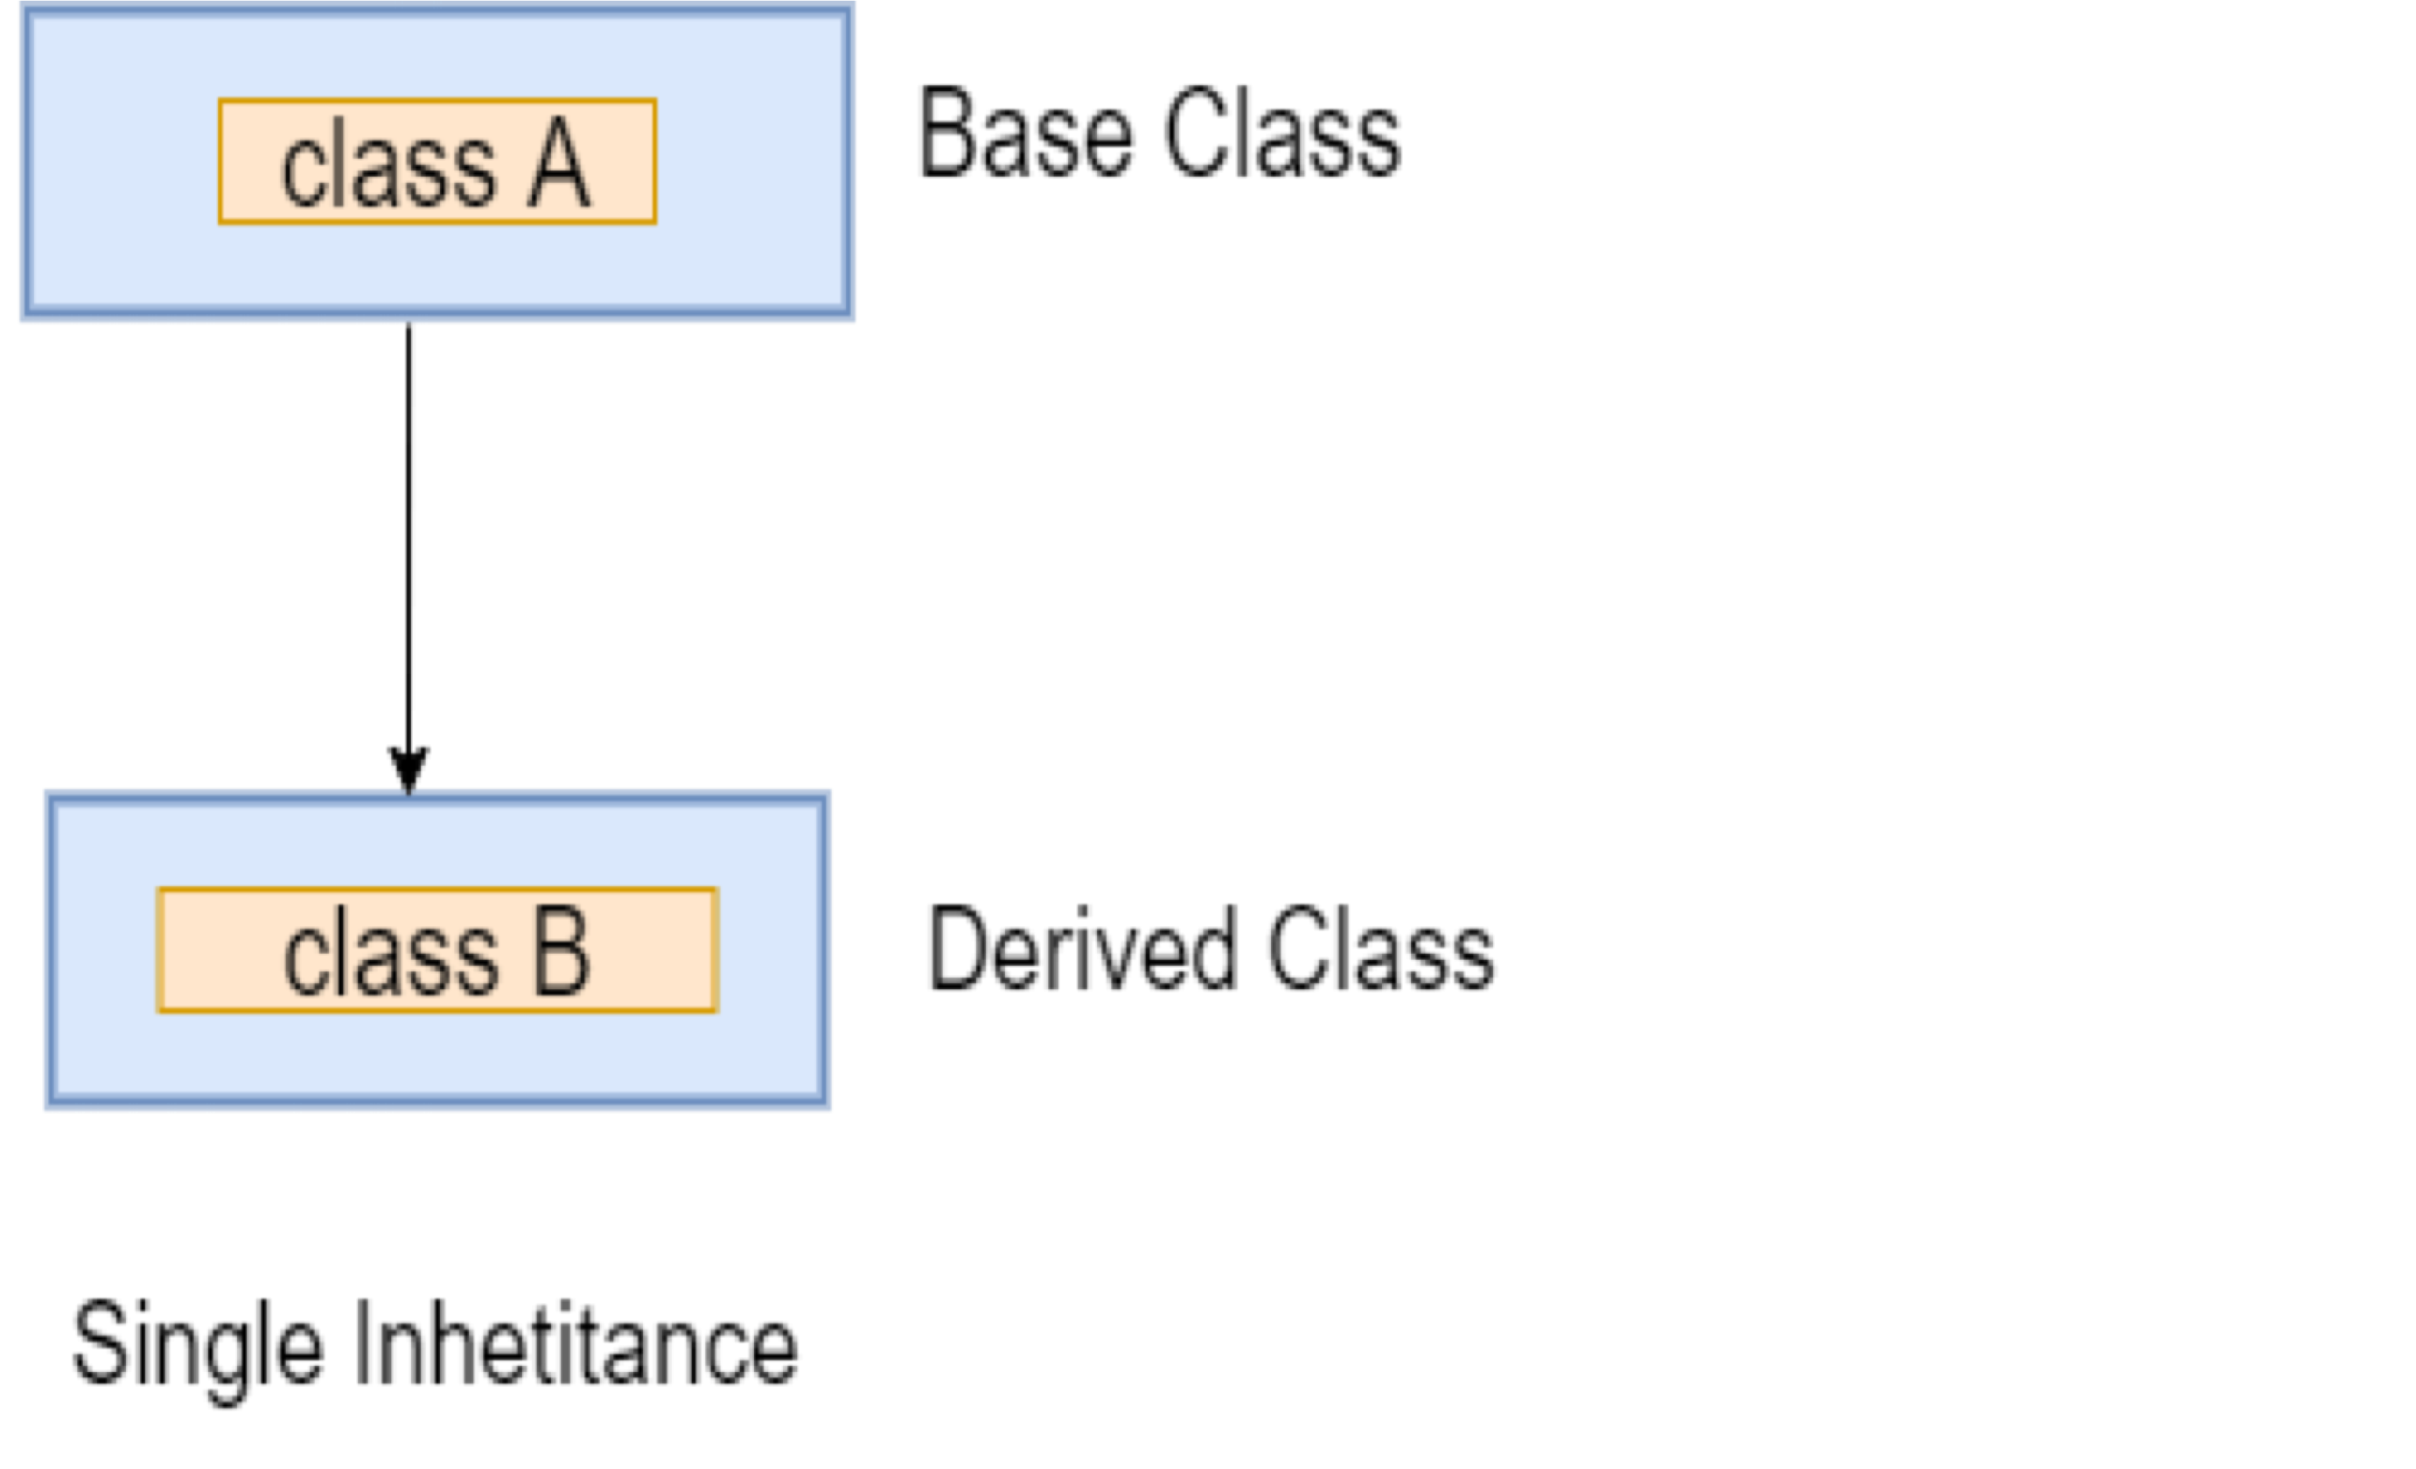
Single Inheritance
In the single inheritance, a class is inherited by a single class or subclass is inherited by one parent class.
class Bird{
void fly()
{
print("The bird can fly");
}
}
class Parrot extends Bird{
void speak(){
print("The parrot can speak");
}
}
void main() {
Parrot p=new Parrot(); p.speak();
p.fly();
}

Slide 12

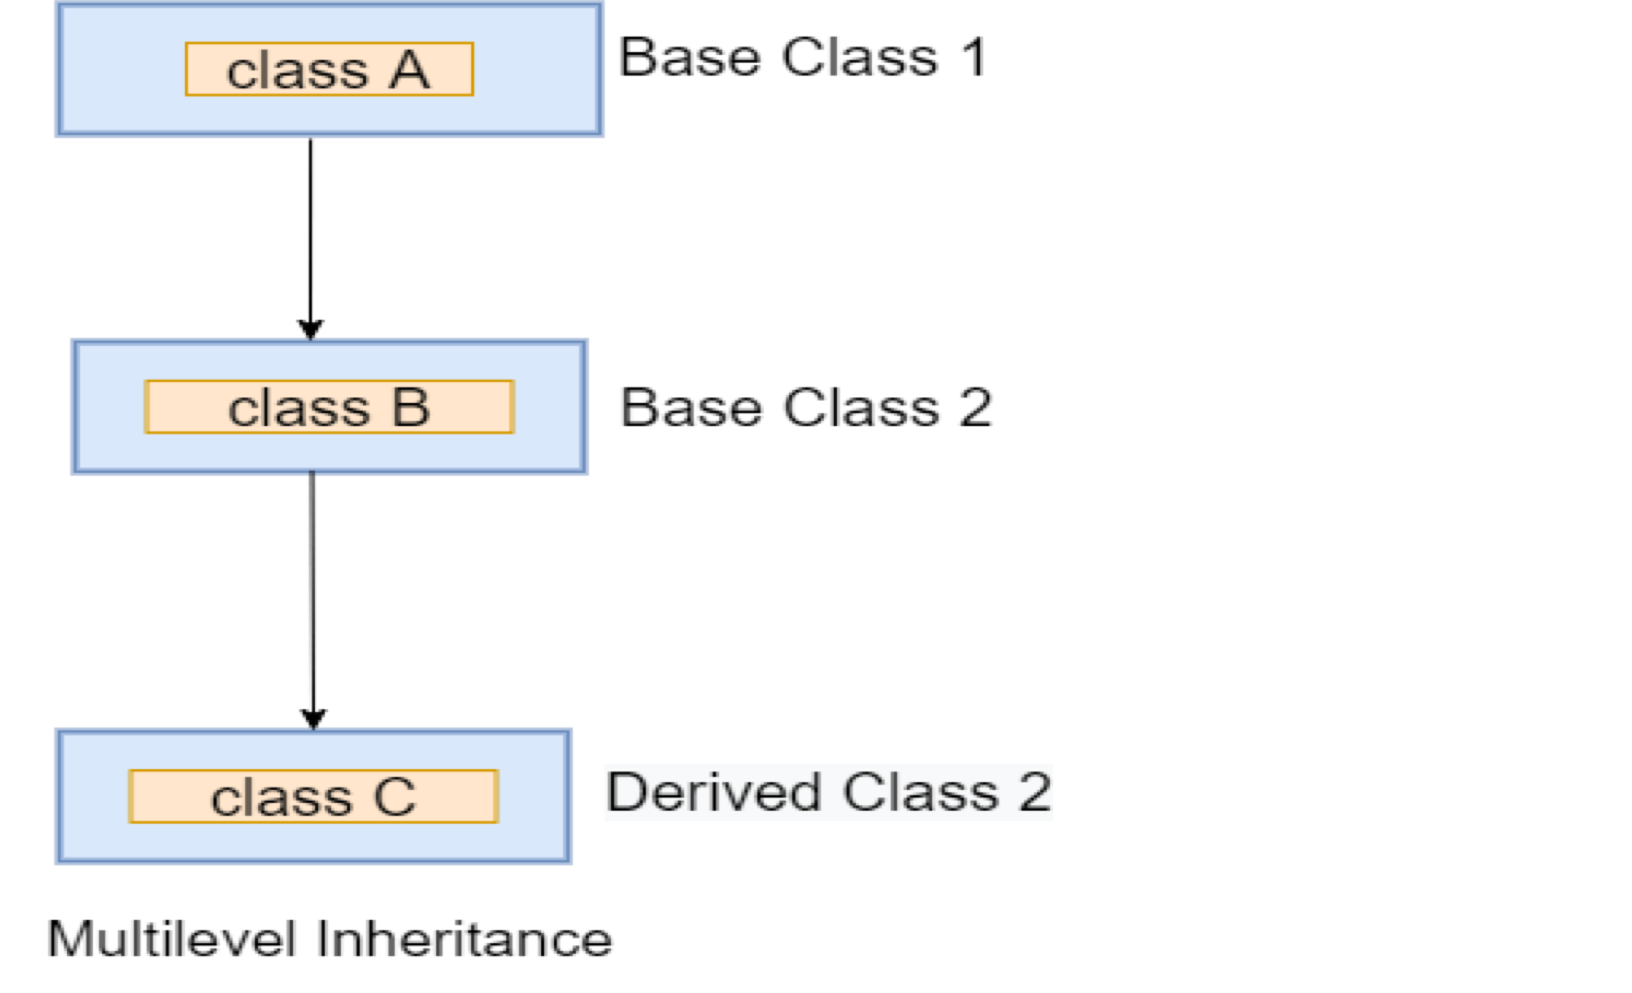
Multilevel Inheritance
In the multiple inheritance, a subclass is inherited by another subclass or creates the chaining of inheritance.
class Bird{
}
class Parrot extends Bird{
}
class Eagle extends Parrot {
}
void main() {
}

Slide 13

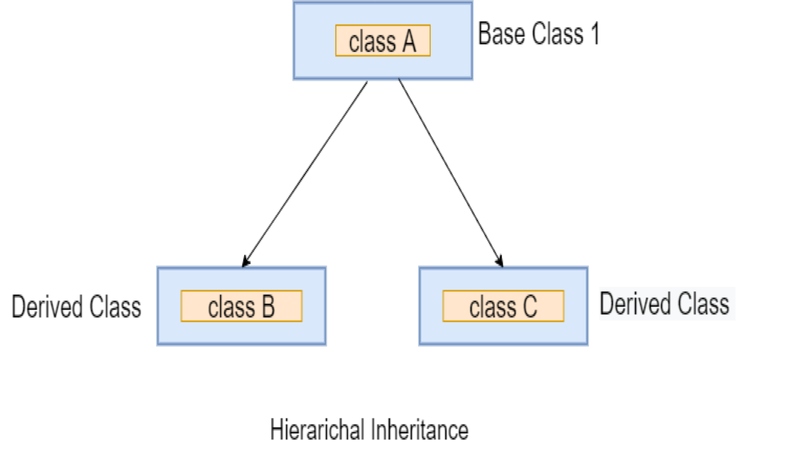
Hierarchical Inheritance
In the hierarchical inherence, two or more classes inherit a single class.
class Person {
}
class Peter extends Person {
}
class James extends Person {
}
void main() {
}

Slide 14
Hierarchical Inheritance
The super keyword is used to denote the instant parent class object of the current child class.
It is used to invoke superclass methods, superclass constructor in its child class.
Syntax: Super.varName super.methodName;
class Parent
{
Parent()
{
print("This is the super class constructor");
}
}
class Child extends Parent
{
Child():super()
{
print("This is the sub class constructor");
}
}
void main() {
Child c = new Child();
}

Slide 15

Method Overriding
When we declare the same method in the subclass, which is previously defined in the superclass is known as the method overriding.
class Human{ void run()
{
print("Human is running");
}
}
class Man extends Human{ void run(){
print("Boy is running");
}
}
void main(){
Man m = new Man(); m.run();
}
The subclass can define the same method by providing its own implementation, which is already exists in the superclass.
The method in the superclass is called method overridden, and method in the subclass is called method overriding.

Slide 16

Method Overriding using super keyword
It can invoke the parent class method without creating its object.
It can be done by using the super keyword in the subclass.
The parent class data member can be accessed in the subclass by using the super keyword.
class Human{ void run()
{
print("Human is running");
}
}
class Man extends Human{ void run(){
super.run();
print("Boy is running");
}
}
void main(){
Man m = new Man();
//This will call the child class version of eat() m.run();
}

Slide 17

Dart Getters and Setters
Getters and setters are the special class method that is used to read and write access to an object's properties.
The getter method is used to reads the value of the variable or retrieve the value and setter method is used to set or initialize respective class fields.
By default, all classes are associated with getter and setter method.
class Student {
String stdName; String branch; int stdAge;
String get std_name
{
return stdName;
}
void set std_name(String name)
{
this.stdName = name;
}
}
void main(){
Student std = new Student(); std.std_name = 'John';
print("Student name is: ${std_name}");
}

Slide 18

Abstract Classes
Abstract classes are the classes in Dart that has one or more abstract method.
Abstraction is a part of the data encapsulation where the actual internal working of the function hides from the users.
Declare the abstract class by using the abstract keyword.
There is a possibility that an abstract class may or may not have abstract methods.
Abstract methods are those methods, which are declared without implementation.
The concrete methods or normal methods are declared with implementation.
An abstract class can contain both types of methods, but a normal class is not allowed to have abstract methods.

Slide 19

Declaring Abstract Class
An abstract keyword followed by a
abstract class Person { void displayInfo();
}
class Boy extends Person
{
void displayInfo() {
print("My name is Johnathon");
}
}
void main() {
Boy b = new Boy(); b.displayInfo();
}
class name is used to abstract class.
Syntax:
abstract class ClassName {
// Body of abstract class
}
declare the

Slide 20

Dart Interfaces
An interface defines the syntax that any entity must adhere to.
Dart does not have any separate syntax to define interfaces.
An Interface defines the same as the class where any set of methods can be accessed by an object.
The Class declaration can interface itself.
The keyword implement is needed to be
class Employee
{
void display() {
print("I am working as an engineer");
}
}
class Engineer implements Employee
{
void display() {
print("I am an engineer in this company");
}
}
void main()
{
Engineer eng = new Engineer(); eng.display();
}
writing, followed by class name to be able to use the interface.
Syntax:
class ClassName implements InterfaceName

